Slide 1
Project -2
Akanksha Mishra
Nexthikes IT Solutions

Slide 2
Introduction
Data Wrangling :Three data sources are combined in to single dataset detecting the gaps and outliers from the dataset
Tools Used: Python (Pandas, NumPy, Seaborn, Matplotlib)
Methodology: Data Cleaning, preprocessing EDA, Visualization, Conclusion
Dataset contains multiple variables relevant to analysis which Includes numerical and categorical data, Missing values, duplicates, data types
Firstly Identified trends and patterns with significant correlations between key variables which results outlier detection and their impact on the analysis

Slide 3
Methodology and datasets overview
Steps followed in data wrangling:
1. Data Cleaning
2. Preprocessing
3. EDA
4. Visualization
5. Conclusion
Dataset used for wringling
Dataset 1: Temperature distribution ('dataset_1.xlsx')
Dataset 2: Temperature distribution ('dataset_2.xlsx’)
Dataset 3:
Combined dataset for correlation analysis (dataset1 and2)
Final dataset after wrangling and correlation analysis

Slide 4
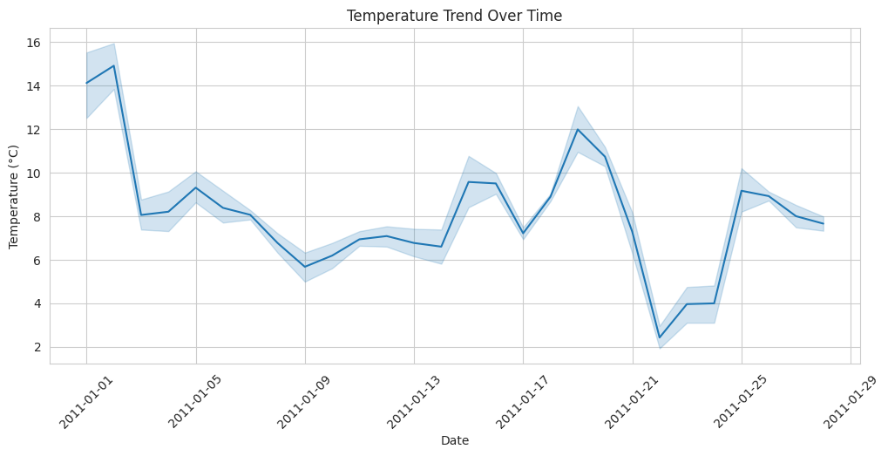
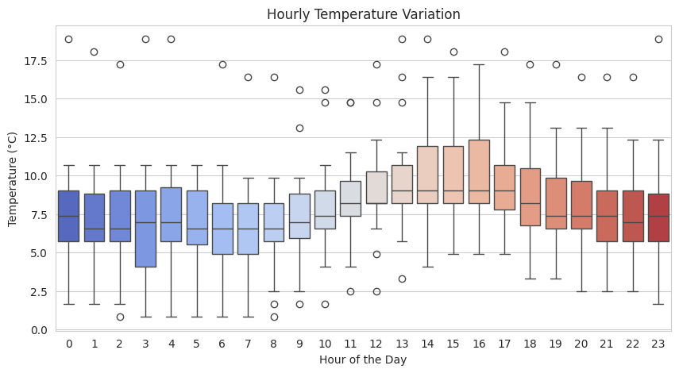
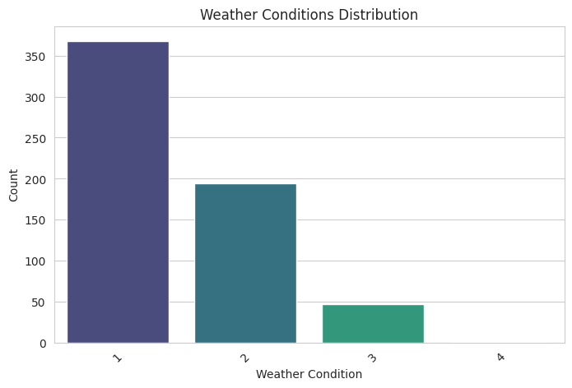
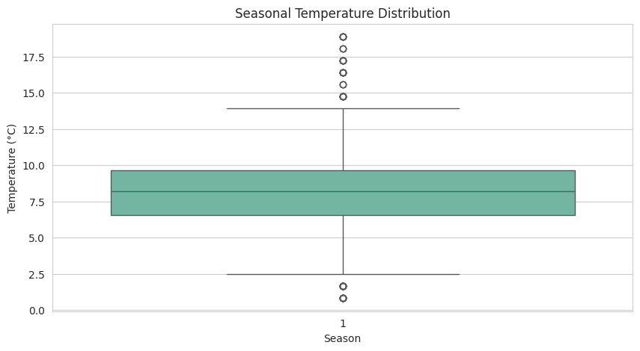
Dataset 1 "/content/nexthikes/dataset_1.xlsx“ Distribution on temperature distribution
Visualizations reveals key trends in temperature data
Outliers affected overall distribution and analysis results

Slide 5
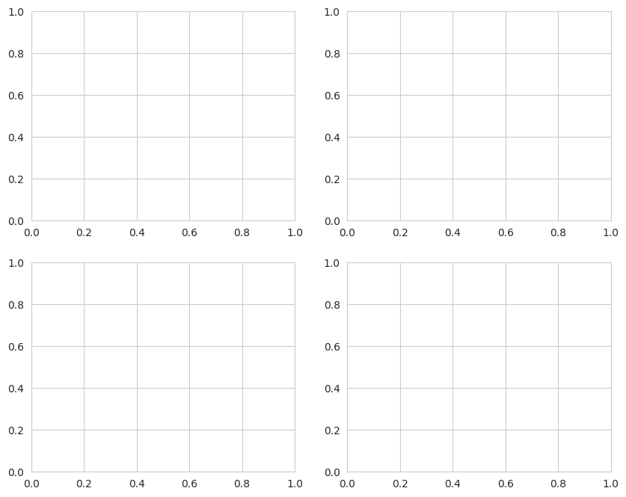
Dataset 2 "/content/nexthikes/dataset_2.xlsx“

Slide 6
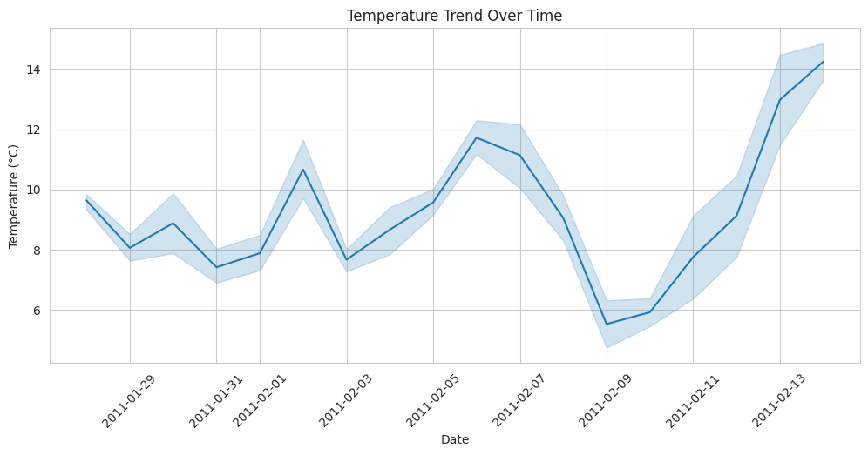
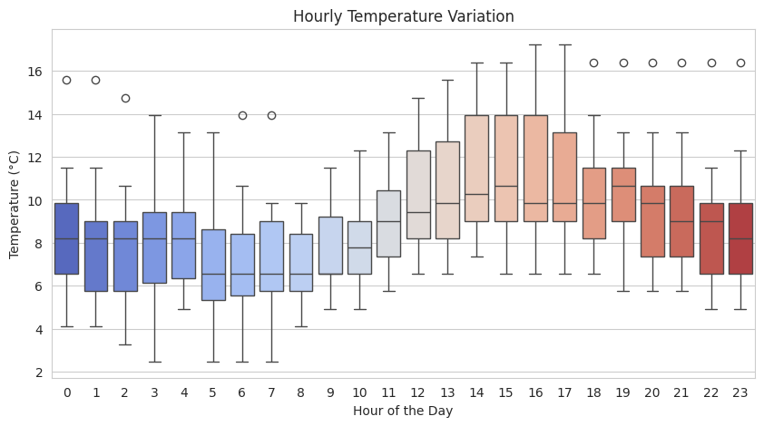
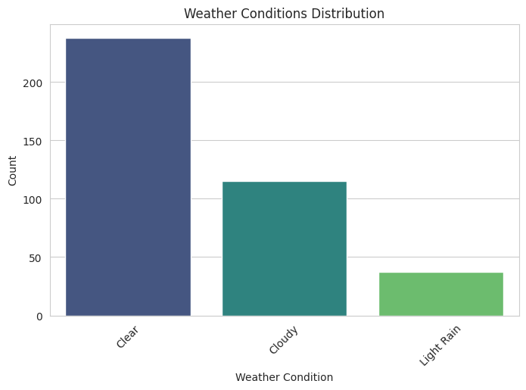

Combined dataset 1&2

Slide 7
Dataset 3
Identified missing values in key columns
Used imputation techniques (mean/median/mode)
Removed rows where necessary
Checked for duplicate entries using Pandas
Removed unnecessary duplicates to avoid skewed analysis
Ensured consistency in data types
Standardized categorical variables
Converted dates into proper format
Used boxplots and Z-score analysis to identify anomalies
Removed extreme outliers affecting trends
Identified patterns and distributions
Detected significant trends in the dataset
Heatmap used to visualize relationships between variables
• High correlation detected between temperature & other factors

Slide 8
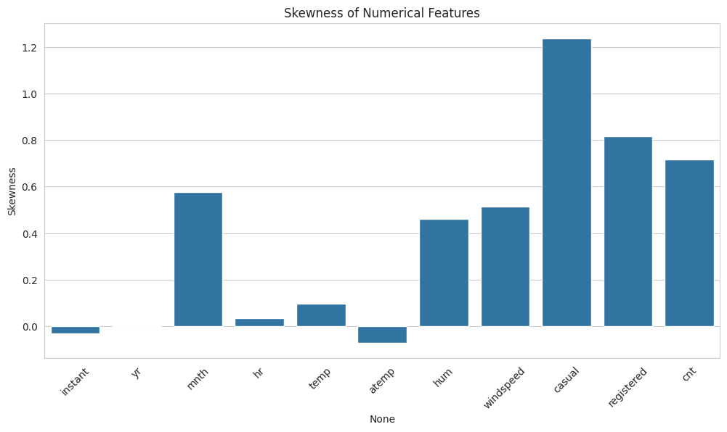
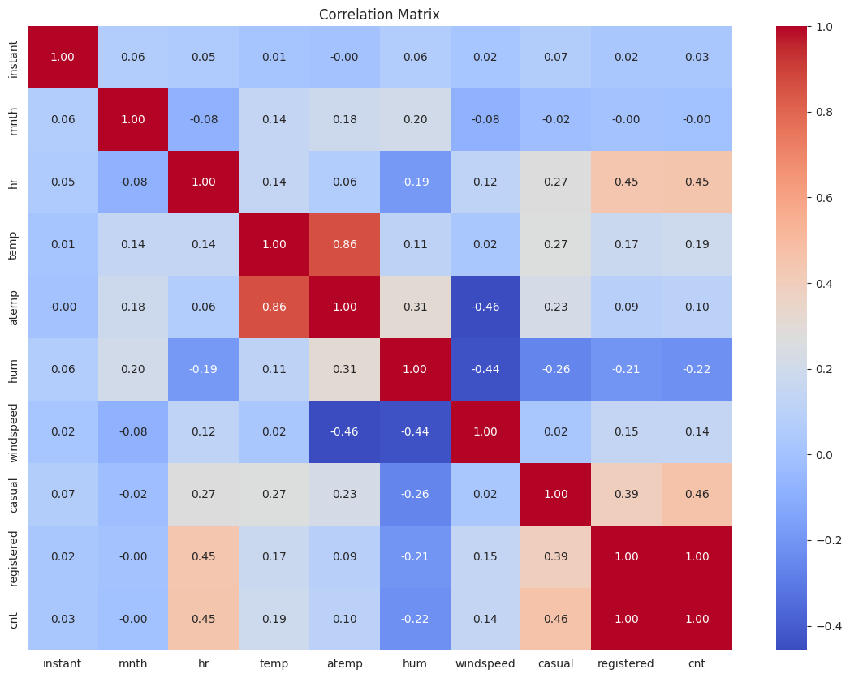
Final dataset correlation matrix

Slide 9
Conclusion
Key Insights : The analysis identified important trends, correlations, and patterns.
Impact: Findings can help in decision-making, optimizing operations, or business growth.
Challenges: Data limitations, missing values, and potential biases were considered.
Recommendations:
Further analysis with more data sources.
Implement predictive modeling for deeper insights.
Automate data collection and visualization for ongoing monitoring.
Next Steps: Present findings to stakeholders and refine analysis based on feedback.

Slide 10
References
Kaggle Courses – Pandas & Data Cleaning
https://youtu.be/x0Sy6Kl0Mzw?si=RornifVBmpAOR4of
https://youtu.be/Aivc3nLV0jU?si=fE3BOk4rErR1XsFU
https://youtu.be/vSyymtg_BVw?si=xc9NPLPc3Fqqwdu4
Kaggle courses pandas and data cleaning
Coursera- data wrangling with python

Slide 11
Thank you

